Slide 1
RATINGS PREDICTION USING NLP
By
VANISREE P G

Slide 2
INTRODUCTION
In recent years, the importance of contextual information has motivated generation of personalized recommendations according to the available contextual information of users. In recent years, we have witnessed a ﬂourish of review websites.
It presents a great opportunity to share our view points for various products we purchase. However, we face an information overloading problem.
How to mine valuable information from reviews to understand a user’s preferences and make an accurate recommendation is crucial. Traditional recommender systems(RS) consider some factors, such as user’s purchase records ,product category, and geographic location.
In this work, we propose a sentiment-based rating prediction method (RPS) to improve prediction accuracy in recommender systems. Firstly, we propose a social user sentimental measurement approach and calculate each user’s sentiment on items/products. Secondly, we not only consider a user’s own sentimental attributes but also take interpersonal sentimental inﬂuence into consideration. Then, we consider product reputation, which can be inferred by the sentimental distributions of a user set that reﬂect customers’ comprehensive evaluation.

Slide 3
At last, we fuse three factors—user sentiment similarity, interpersonal sentimental inﬂuence, and item’s reputation similarity—into our recommender system to make an accurate rating prediction.
We conduct a performance evaluation of the three sentimental factors on a real-world dataset collected from Yelp. Our experimental results show the sentiment can well characterize user preferences, which helps to improve the recommendation performance.
The text of a review is often overlooked in such predictive tasks in favour of features such as the user’s and business previous rating history.
Thus, it is essential to be able to predict what the user feels about a business from the review text and this is the task of rating prediction from review text was chosen.

Slide 4
PROBLEM STATEMENT
We have a client who has a website where people write different reviews for technical products. Now they are adding a new feature to their website i.e. The reviewer will have to add stars(rating) as well with the review. The rating is out 5 stars and it only has 5 options available 1 star, 2 stars, 3 stars, 4 stars, 5 stars. Now they want to predict ratings for the reviews which were written in the past and they don’t have rating.
So we, we have to build an application which can predict the rating by seeing the review.

Slide 5
Data Sources
The most critical aspect of this project is the accumulation of knowledge. To prepare the models, the distinct well springs of the data on e-commerce websites flipkart.com. using selenium and saved in CSV file.
scrape around 20000 rows of data . Review are collected for this project.
The data descriptions are as follow (26023, 7)rows and columns. To predict
rating using Regression. I will start by importing all the necessary libraries that we need for this task and import the dataset.
1) Importing libraries
2) Importing the dataset
Our target is to find the insights of the data and to do thorough data analysis..

Slide 6
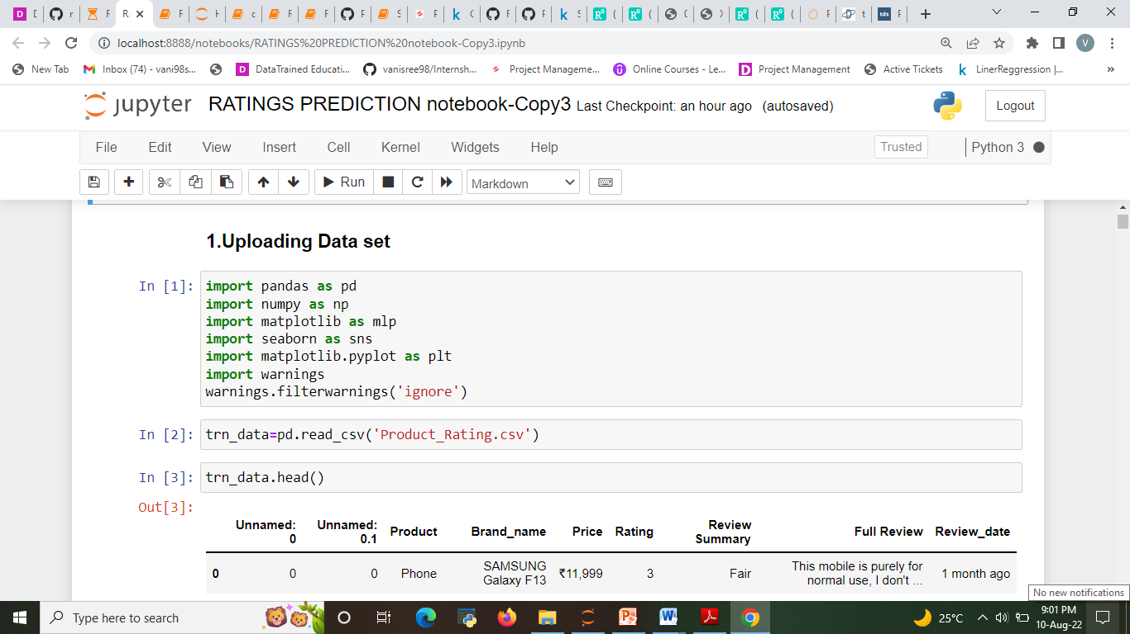
DATA UPLOADING

Slide 7
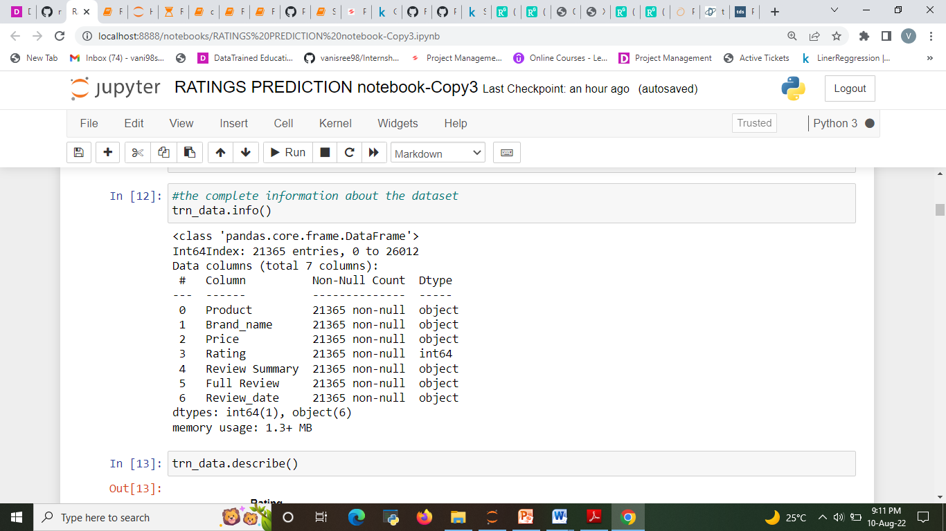

Slide 8
Data Pre-processing Done
Convert the text to lowercase
Remove the punctuations, digits and special characters
Tokenize the text, filter out the adjectives used in the review and create a new column in data frame
Remove the stop words
Stemming and Lemmatising
Applying Text Vectorization to convert text into numeric

Slide 9
MODELS USED
Regression Model with following algorithms
Linear Regression
Decision Tree Regression
Random forest regression
Gradient Boosting Regression
Ridge
SVR
Evaluation metrics
Accuracy Score
classification Report
Confusion matrix

Slide 10
Testing of Identified Approaches (Algorithms)
Listing down all the algorithms used for the training and testing.
LR=LinearRegression()
DT=DecisionTreeRegressor()
GBR=GradientBoostingRegressor()
rf=RandomForestRegressor()
R=Ridge()

Slide 11
Word Cloud for getting word sense
A word cloud is a simple yet powerful visual representation object for text processing, which shows the most frequent word with bigger and bolder letters, and with different colors. The smaller the the size of the word the lesser it’s important
Significant textual data points can be highlighted using a word cloud.

Slide 12
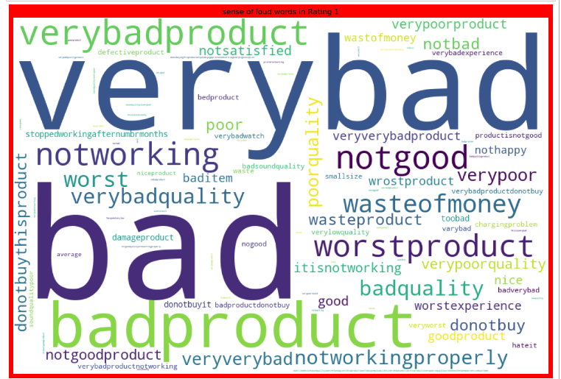
Getting sense of loud words in Rating 1

Slide 13
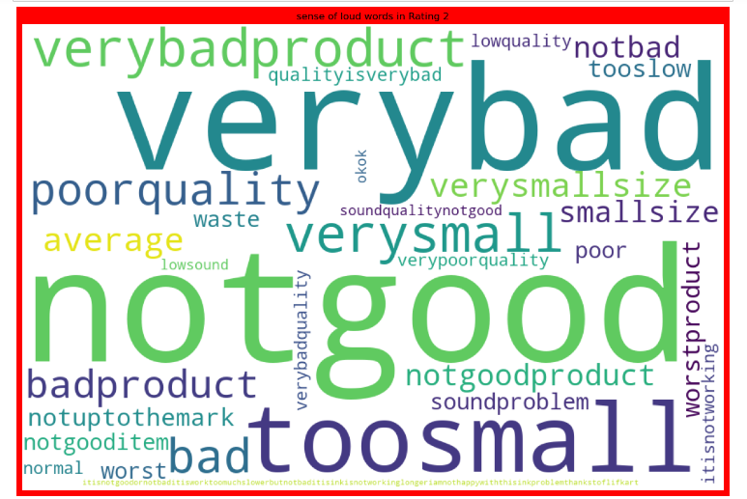
Getting sense of loud words in Rating 2
Getting sense of loud words in Rating 5

Slide 14
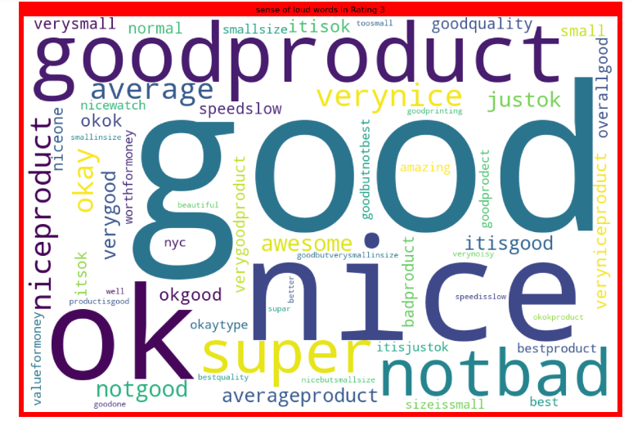
Getting sense of loud words in Rating 3

Slide 15
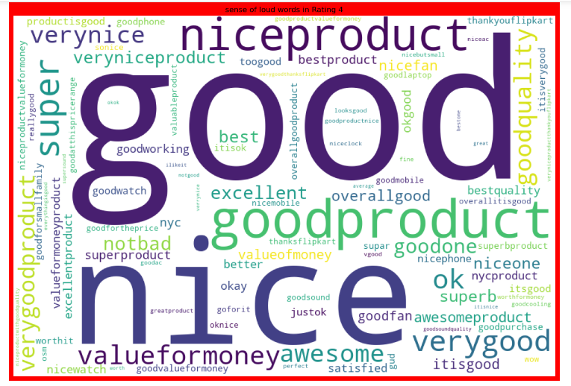
Getting sense of loud words in Rating 4

Slide 16
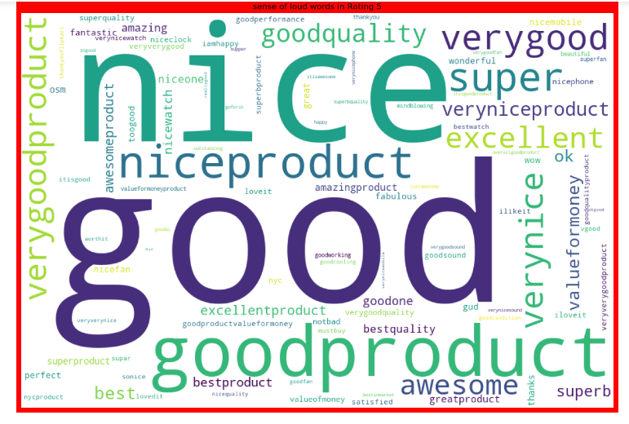
Getting sense of loud words in Rating 5

Slide 17
Machine Learning MODELS USED
Regression Model with following algorithms
Linear Regression
Decision Tree Regression
Random forest regression
Gradient Boosting Regression
Ridge
SVR
Machine Learning Evaluation Matrix
Accuracy Score
Confusion matrix of Model

Slide 18
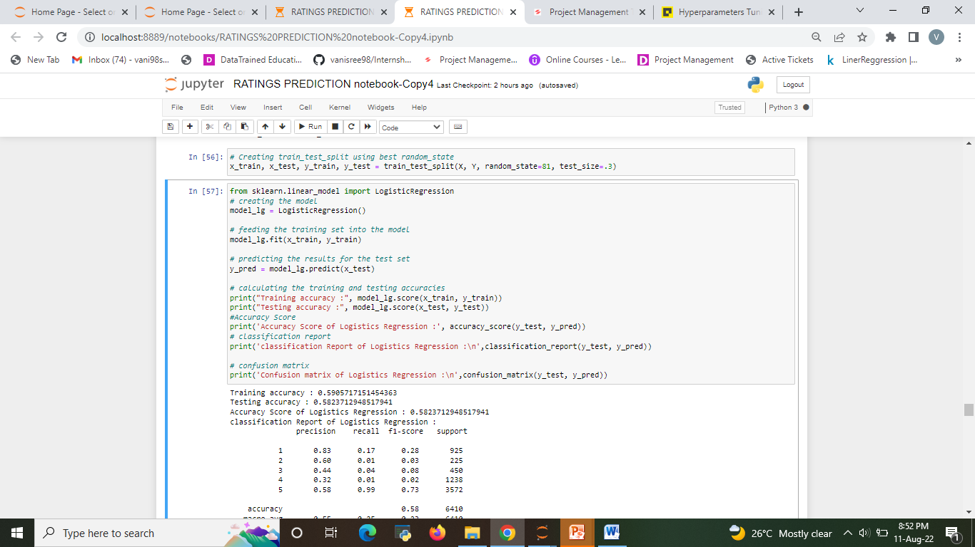
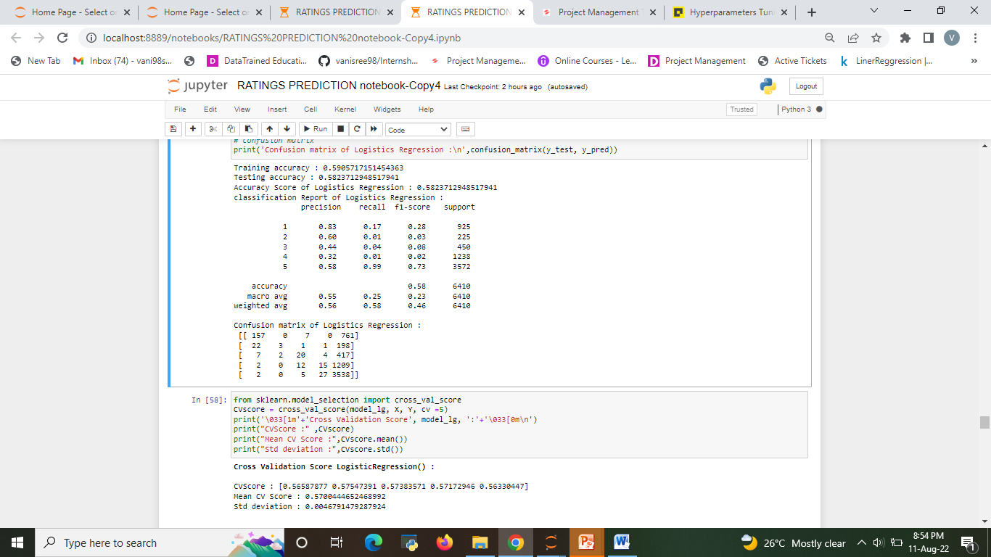
Run and Evaluate selected models 1.Linear Regression
Describe all the algorithms used along with the snapshot of their code and what were the results observed over different evaluation metrics.

Slide 19
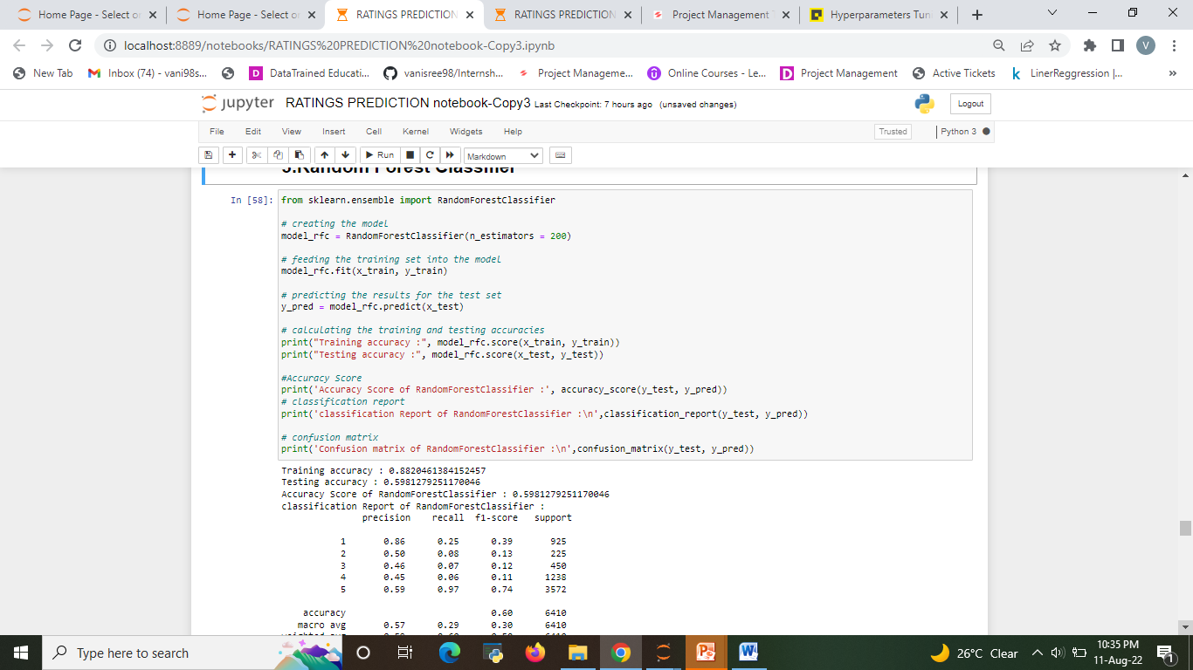
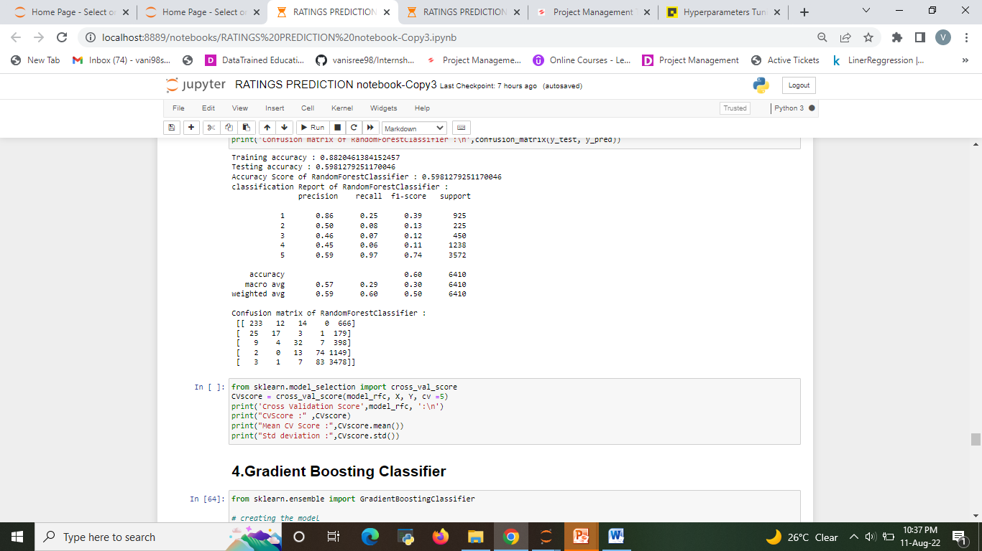
2.Random Forest Regressor

Slide 20
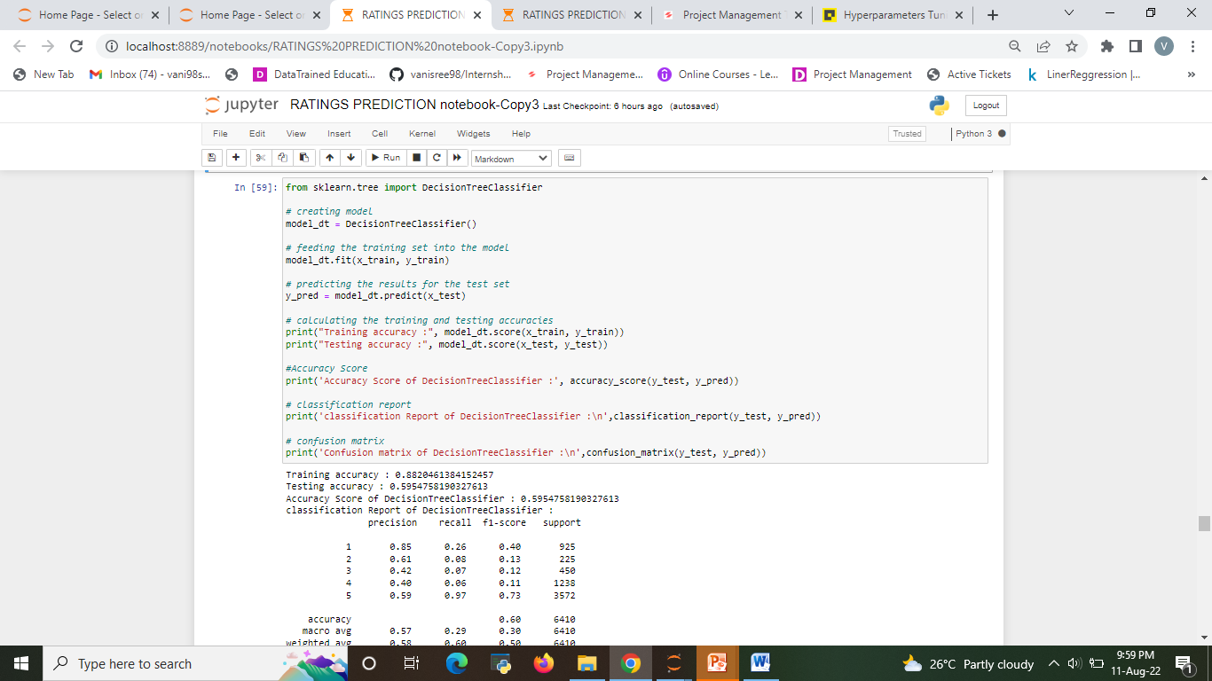
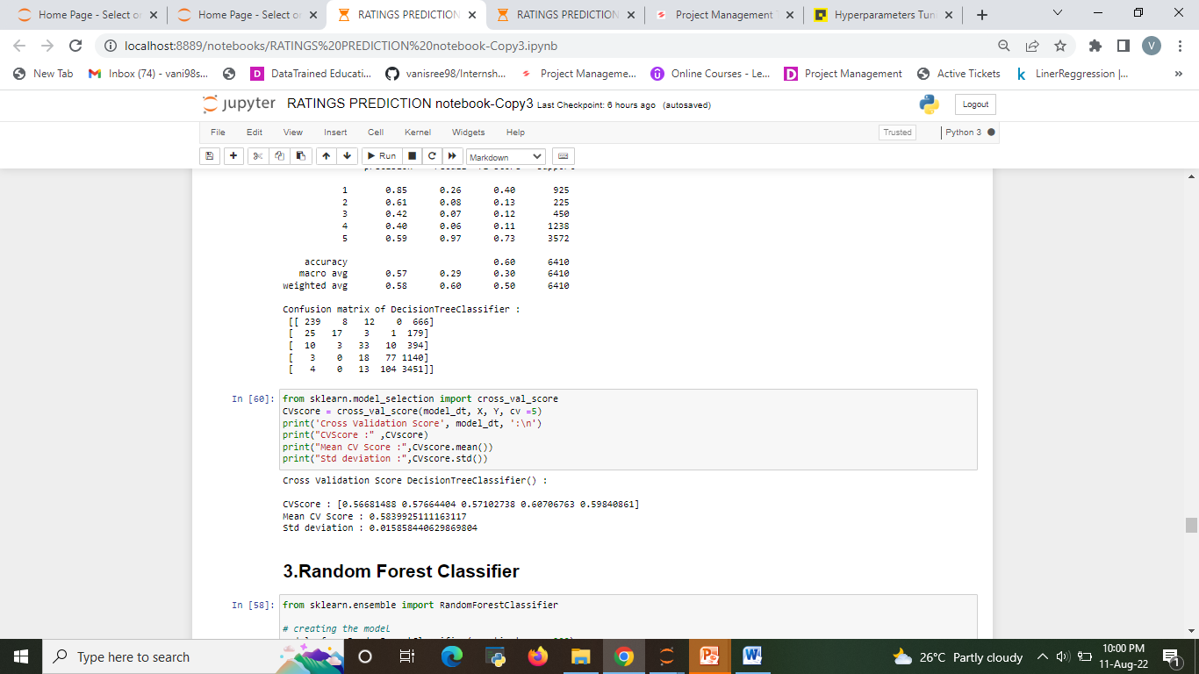
3. Decision Tree Regression

Slide 21
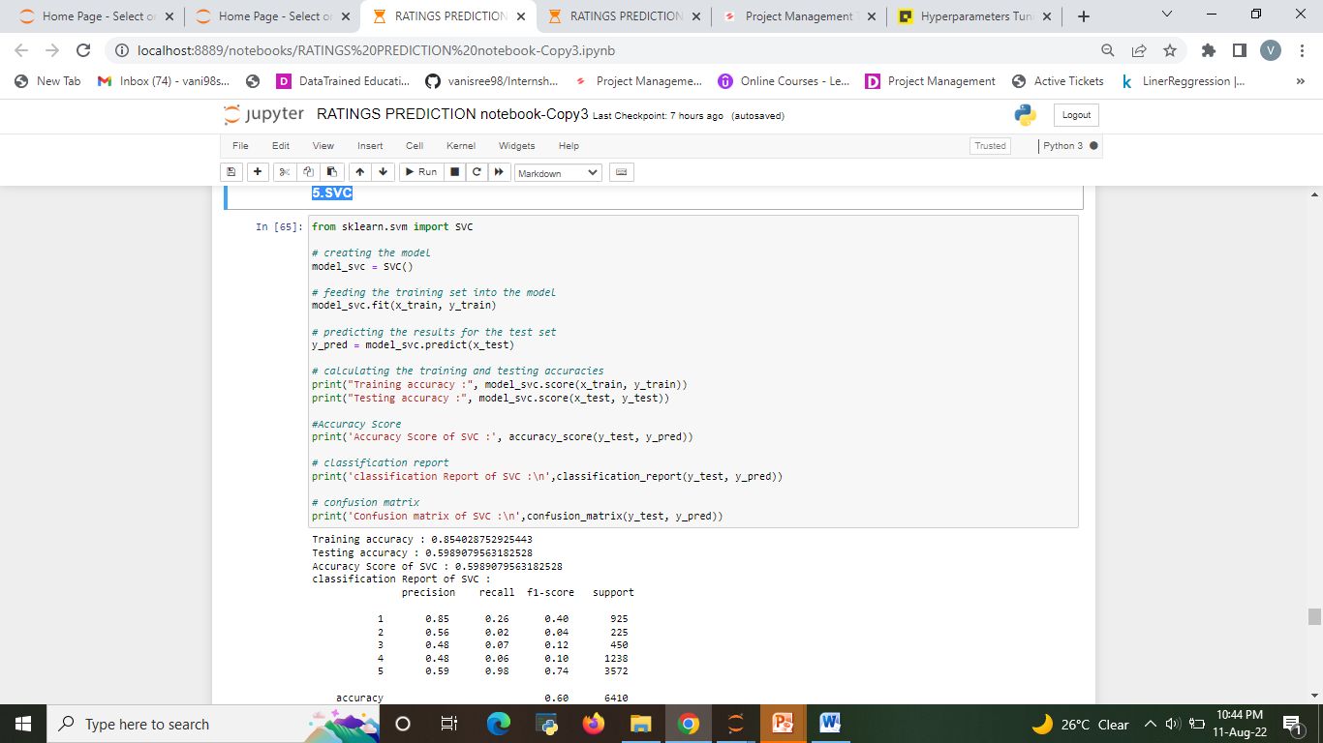
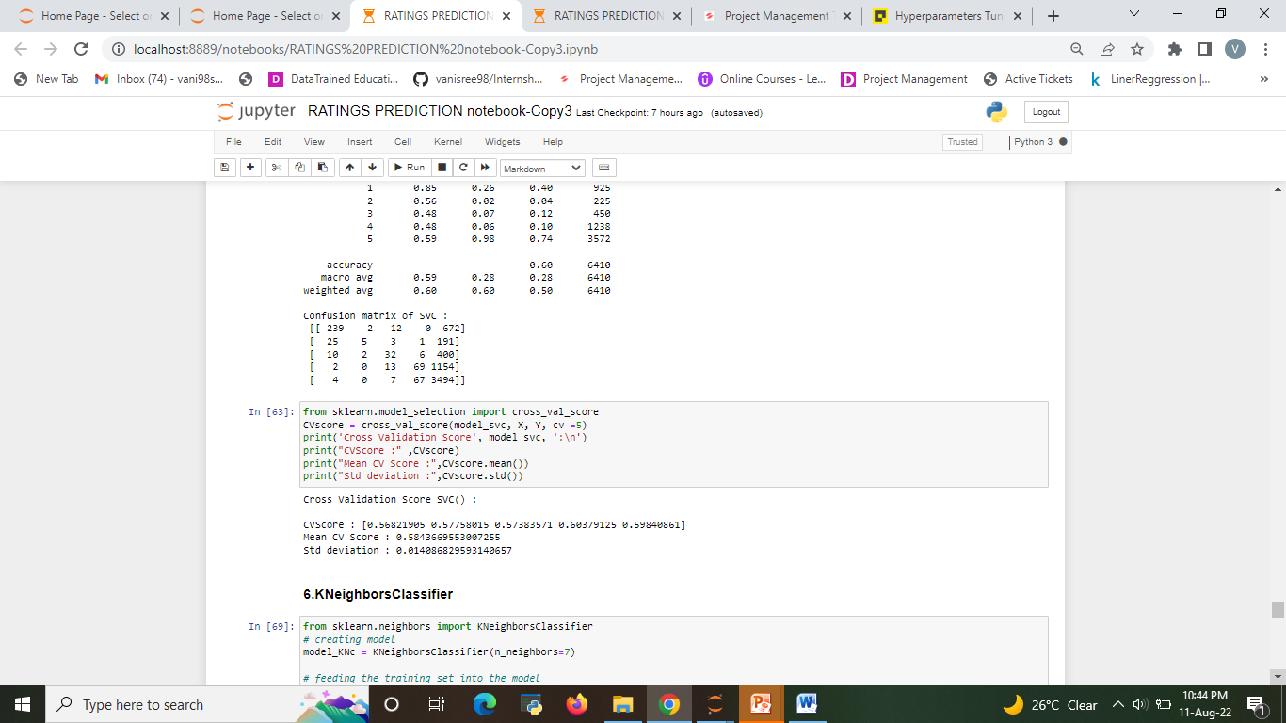
4.SVR

Slide 22

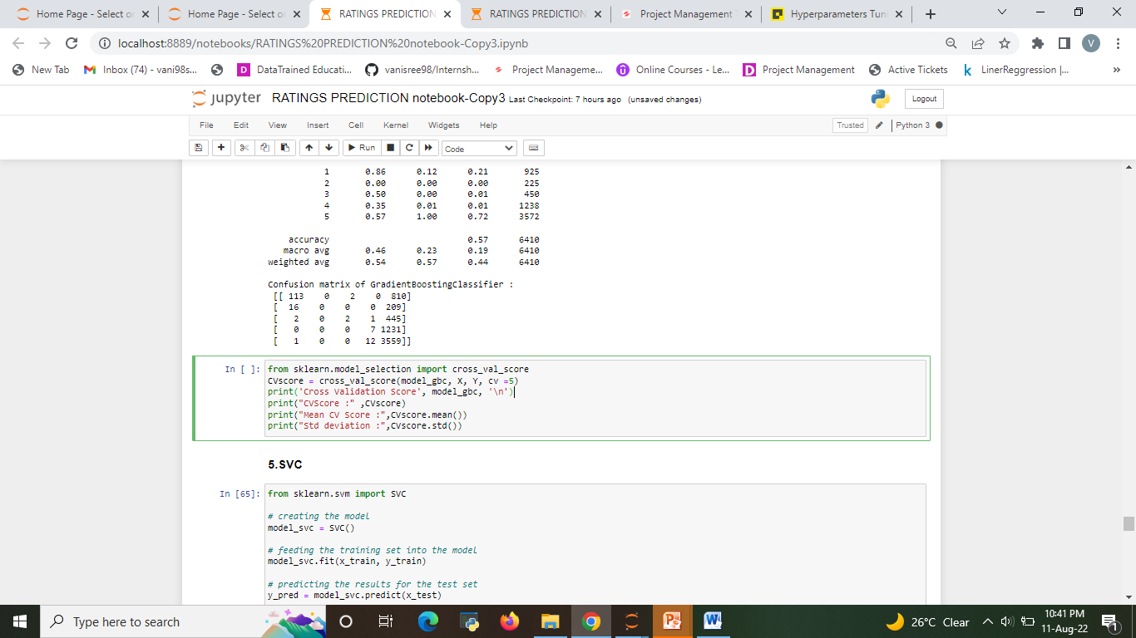
5. Gradient Boosting Regression

Slide 23
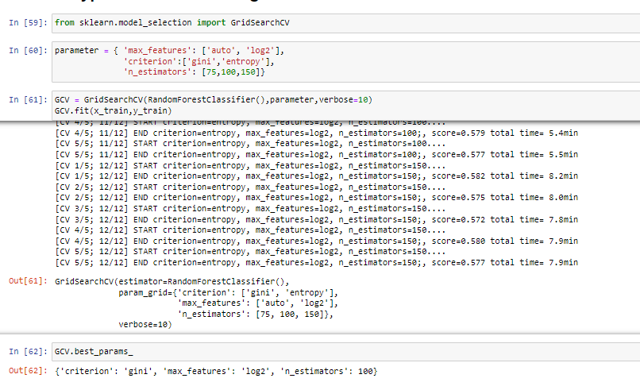
Hyper parameter tuning 1.Random Forest Regressor

Slide 24
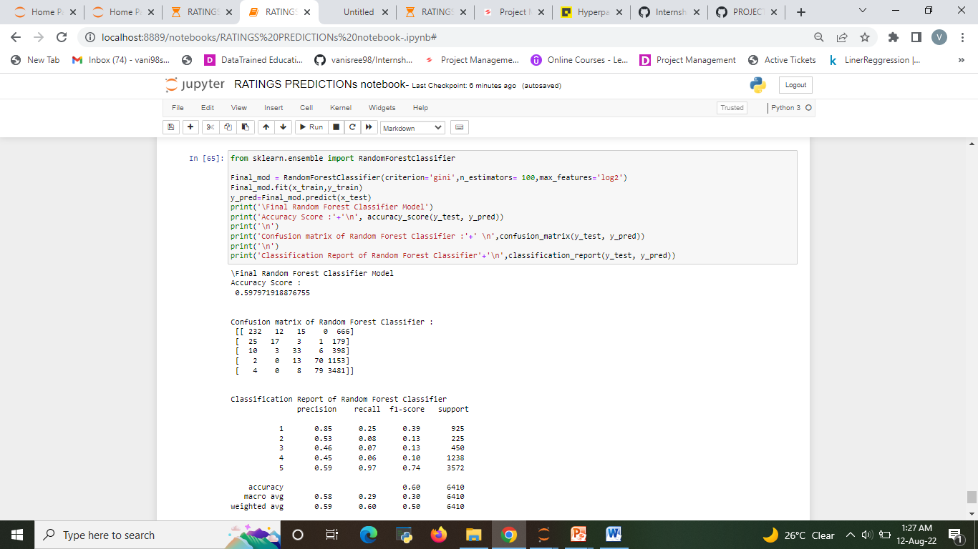

Slide 25
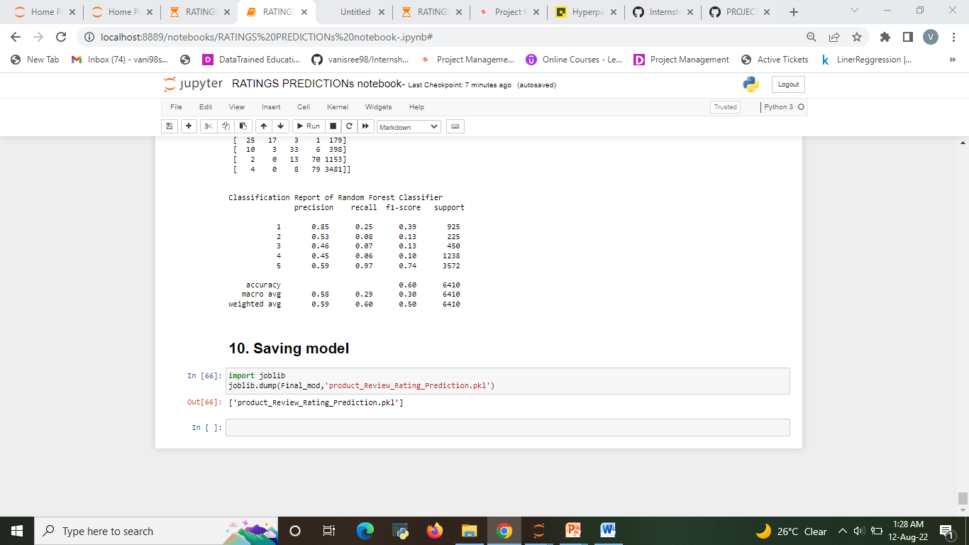
FINAL MODEL
The best model after hyper parameter tuning is Random Forest Regression

Slide 26
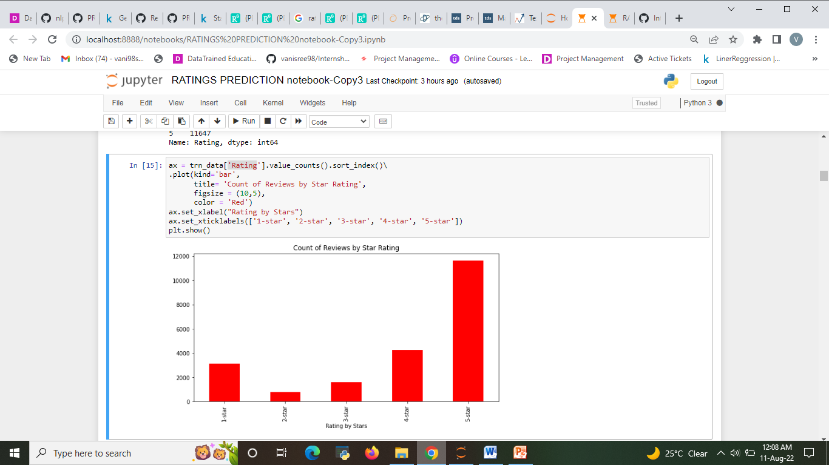
Visualizations
The Analysis of Rating of product based on review

Slide 27
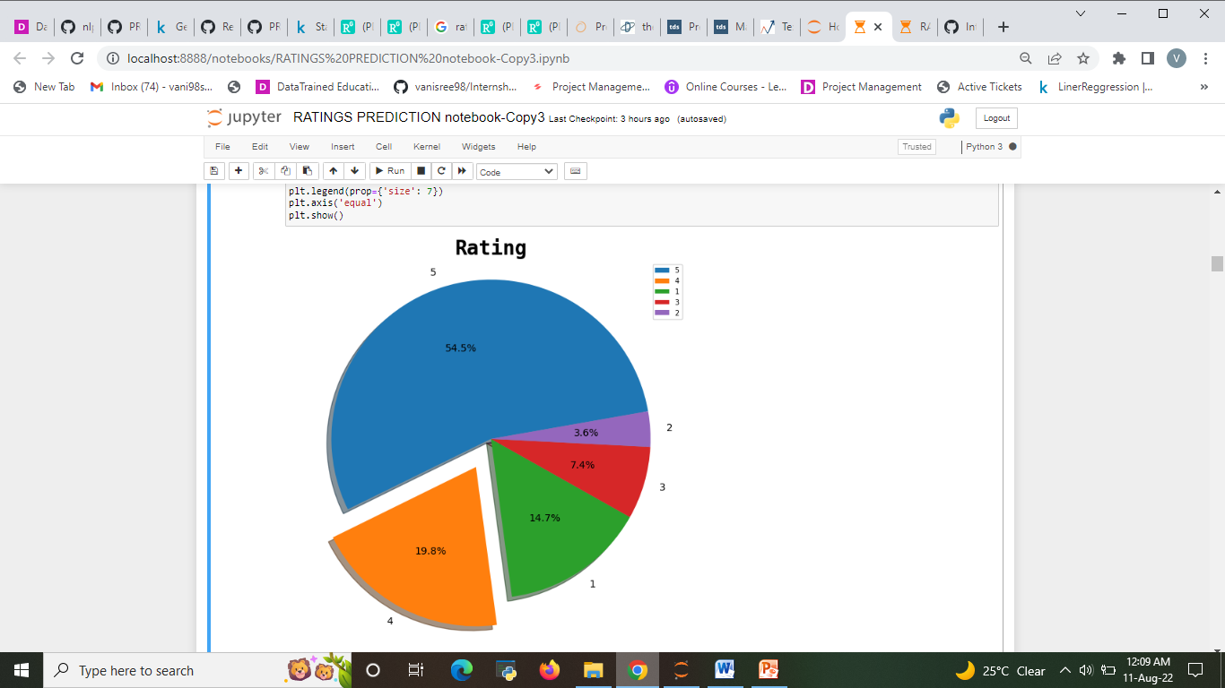
Around 54.4% customer given 5- star rating followed by 14.7% customer given lowest 1-star rating.
Around 19.8% customer given 4- star rating followed by 7.4% customer given lowest 3-star rating.
The Analysis of The name of the airline

Slide 28
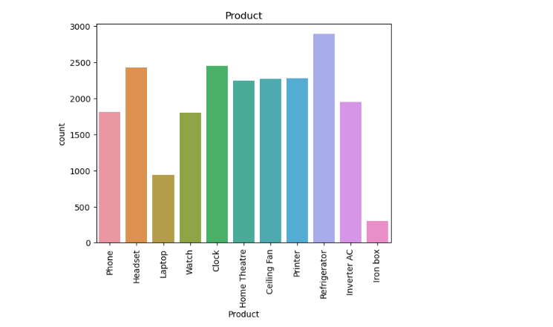
The Analysis of product
In observation from fig:3 Refrigerator has high amount review are compare with iron box

Slide 29
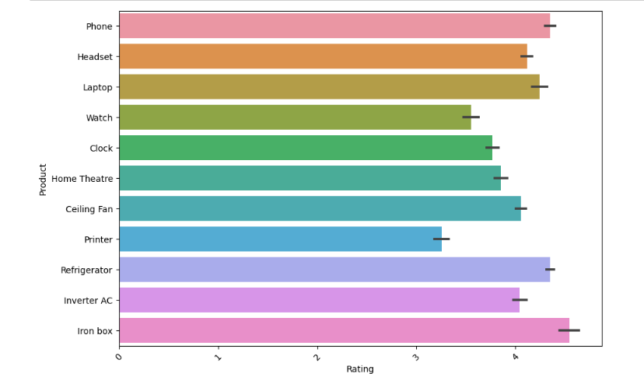
The Analysis of The Rating and product
From f iron box and phone have above 4 star rating.
Printer and watch have 3 star rating compare with all product.

Slide 30
Conclusion
From this dataset I get to know that each feature play a very import role to understand the data.
Data format plays a very important role in the visualization and Appling the models and algorithms ‘
There are manysystems which uses different machine learning algorithms such as Logitic Regression (LR), Decision Tree, Support Vector Machine (SVM), Random Forest Algorithm, etc for predicting the rating of product.
In this ML based system, we are using Random Forest Algorithm which gives more accuracy in predicting the rating.. It is easy to use and it gives more accuracy in prediction. It requires less time for prediction and it helps in reduction of over fitting.

Slide 31
Limitations and Scope
For conducting the experiments in this thesis, no pre-processing has been done on the data set. Pre-processing is the process where the data is being cleaned and prepared before being fed to the algorithms.
Online reviews usually contain many irrelevant and uninformative features which may not even have an impact on the orientation of them.
This process involves removing many steps such as 17 white space removal and stop words removal etc. The results from all experiments implies that both approaches give higher accuracies when they are being applied on the summaries of the reviews.

